Slide 1
ENCOUNTERS WITH JESUS
How Jesus Changes Lives – Then and Now
1
3
5
Fishing For People
The Healing at the Pool
Luke 5:1-11
John 5:1-15
The Woman at the Well
The Paralysed Man and His Friends
A Man Under Authority
John 4:4-42
2
4
Luke 7:1-10
Luke 5:17-26

Slide 2
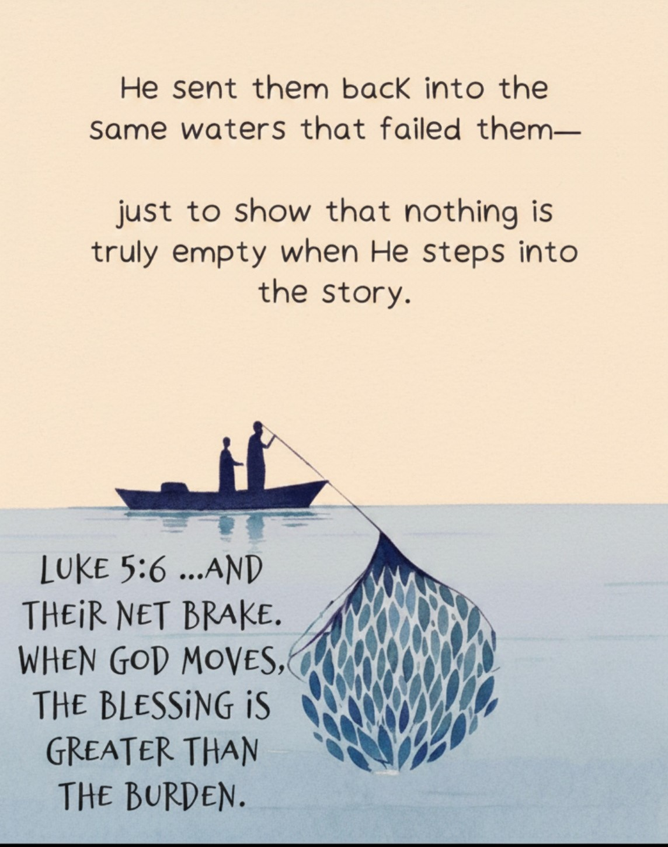

Slide 3
PETER’S ENCOUNTER WITH JESUS AT THE LAKE OF GENNESARET LUKE’S ACCOUNT LK5: 1-11
WHAT IS REALLY GOING ON HERE
Cultural and Historical context
WHAT DO WE LEARN ABOUT JESUS HIMSELF
WHAT DO WE LEARN ABOUT OTHERS IN THE ENCOUNTER
HOW DOES IT RELATE TO YOU AND ME TODAY
Key Questions:
We will discuss the many learnings during our CG.
Let us look at Peter’s doubts and how Jesus helped him.
Peter’s doubts about Jesus’ fishing abilities progress to doubts about himself Lk 5:4-5
The first doubt was overcome by a miracle and the second by a promise Lk 5: 6-10
Rom 4: 20-21, Heb 4:2 NIV NKJV
To get a good view of this encounter, let us look at other writers account of the same event
Matt 4:18 - 22
Mark 1: 16-20
John 1: 40 - 42
Jesus knew them and they also knew Jesus before these encounters from John’s account. Lk4:38
This was the moment of decision for these young men to commit to Jesus
I believe this was not a coincidence for Jesus, He has already prayed them in, the fishing of men is a process.
Whenever we yield our vessels to Jesus it always turns out for our profit
We must decide to commit to Jesus
We must follow Jesus’ process of prayerfully fishing men into God’s kingdom

Slide 4
ENCOUNTERS WITH JESUS
Key Learnings for CG discussions
How Jesus Changes Lives – Then and Now
WHAT DO WE LEARN ABOUT JESUS HIMSELF
WHAT DO WE LEARN ABOUT OTHERS IN THE ENCOUNTER
HOW DOES IT RELATE TO YOU AND ME TODAY
He is always there to help us with our doubts in his abilities and our self doubt
He is there to build our capabilities and help us become who he has made us. To fulfil our destiny in Him
God will always out-perform us even in things we think we know and understand because he is God
We must learn to do it at His word like Peter.
Before we were born Jesus knew us
Don’t relent in sharing the good news with those around you, and it must be targeted and prayerful
Nothing is truly empty whenever God steps into the story
We must decide to commit to Jesus and also commit to follow his process of prayerfully spreading His good news to the world around us
We must follow Jesus’ example to always engage every life decision with prayers

